Slide 1
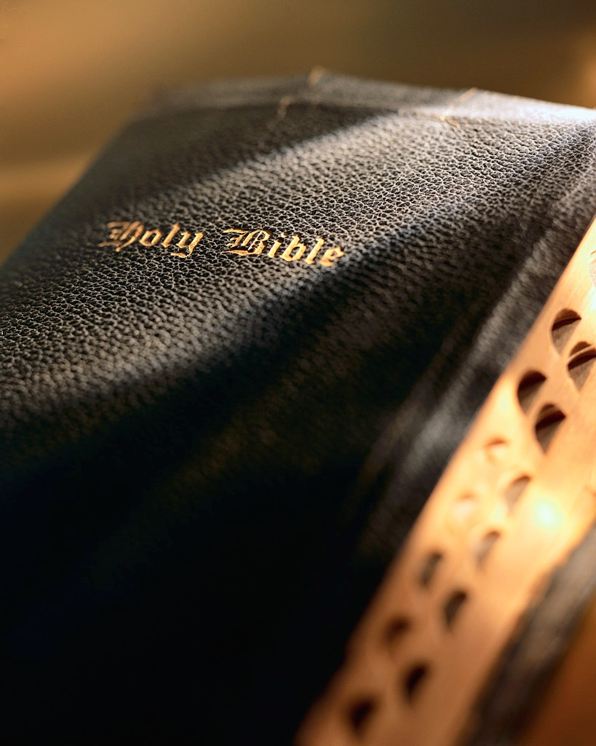

Slide 2
Praying In Faith

Slide 3
Praying In Faith
Matthew 21:22
Mark 11:22-24
1 Timothy 2:8
James 1:5-8

Slide 4
Praying In Faith
Faith In Prayer’s Effectiveness
Faith In God’s Power
Faith In God’s Care
Faith In God’s Answer

Slide 5
God’s Plan For Saving Man
Hear the Word – Matt. 17:5
Believe in the Lord – Jn. 8:24
Repent of Your Sins – Ac. 17:30
Confess Your Faith – Matt. 10:32
Be Baptized – Mk. 16:16
Remain Faithful – 1 Cor. 15:58

